Slide 1
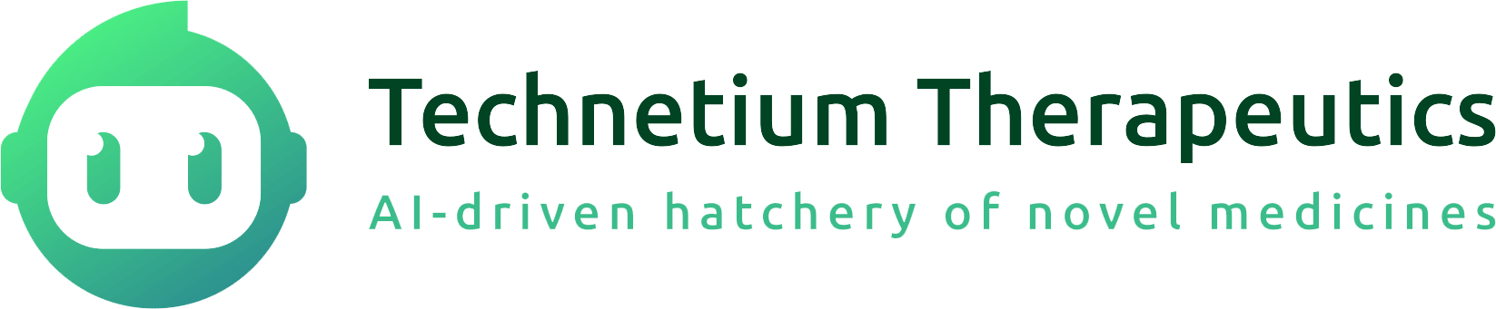
The Founders
Re-inventing the Process How Drugs Are Invented
Our Platform: AI Drug Design, DRUG-seq and Lab Automation
Our Pipelines, Clinical Differentiation Strategy and Business Strategy
Technetium THERAPEUTICS
March 2025

Slide 2
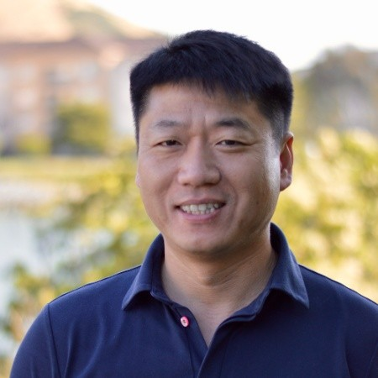
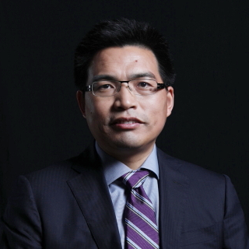
We Are Domain and AI Experts
Cheng Hu
Chunlin Wang
Co-Founder, CEO
Co-Founder, CTO
Director of medicinal chemistry and team lead for over 10 drug discovery projects
Co-lead of Atomwise AI model development to support drug discovery projects
Founder of several successful companies in the biotech industries
Inventor of several innovative algorithms that have become industry standards
Technetium Therapeutics founders are biotech industry veterans who are at the forefront of AI applications

Slide 3
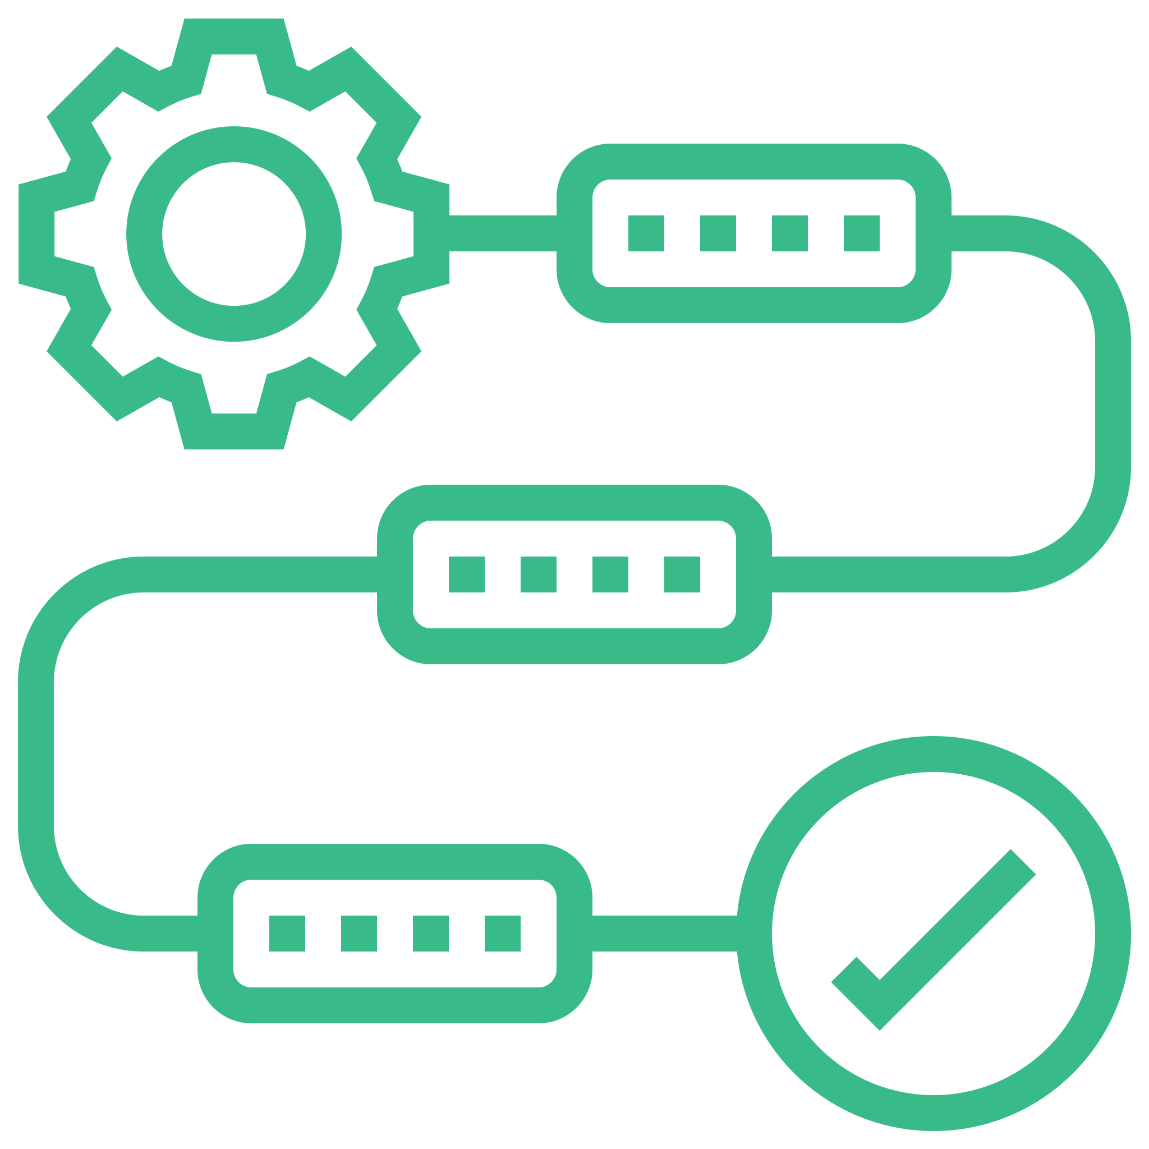


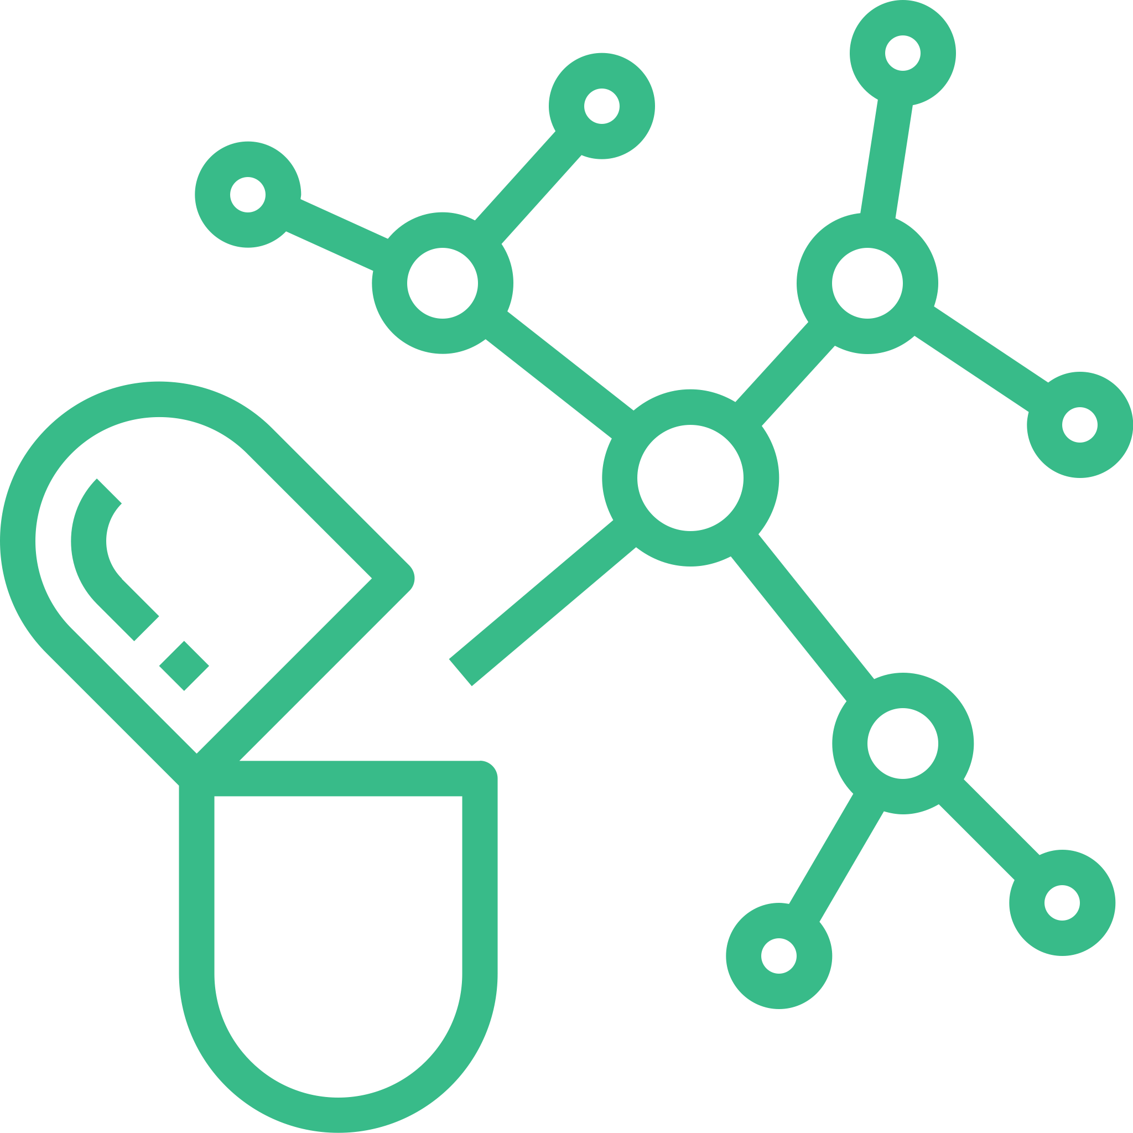
Why We Focus on Design, Not Discovery
High-throughput screening and trial-and-error methods can be time-consuming, expensive, and yield fewer viable candidates
Drug design benefits from advancements in computational biology and AI
Drug design allows for the creation of synthetic molecules with specific properties, such as gut-restriction, CNS penetration, etc.
Drug design enables the creation of drugs tailored to individual genetic profiles (EGFR mutants) or specific disease subtypes
Technological progress is driving the transition from traditional drug discovery to innovative drug design

Slide 4



Invent Novel Medicines, Much Faster
Our proprietary AI Agentic Workflow generates novel chemotypes, enabling the development of innovative drugs with superior clinical performance
By integrating Drug-Seq into the drug development process, we can optimize drug candidates, reduce costs, and improve the success rates of novel medicines
Incorporating automation into the drug development process, particularly in lead optimization, can significantly accelerate drug development
Technetium Therapeutics is leveraging AI, DRUG-seq and automation to develop best-in-class, novel medicines

Slide 5
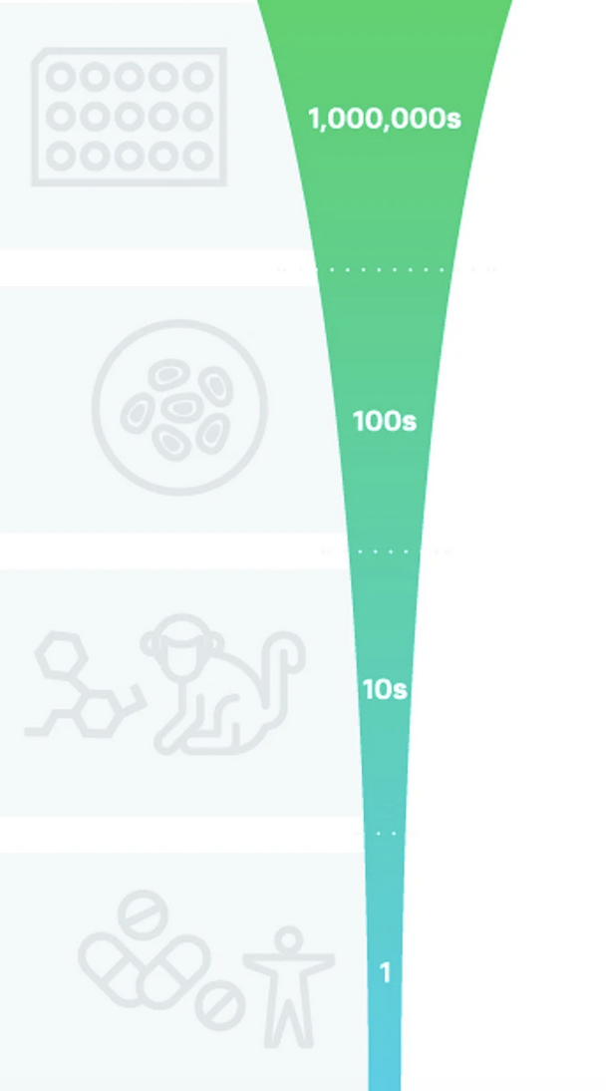
Traditional Drug Screening Process
High Throughput Screening
6-12 Months
$300K-500K
Lead Optimization
12-18 Months
$2-3 millions
Candidate Selection
12 months
$3-4 millions
IND Enabling
12 months
$4-5 millions
Developing one clinical candidate with traditional process typically costs $10 million and takes 4 to 5 years

Slide 6
Our AI-Driven Drug Design Process
Lead Design and Validation
8-12 weeks
$30-50K
Lead Optimization (PCT Filing）
12-16 weeks
$100-200K
Candidate Selection
6-9 months
$1-2 millions
IND Enabling
6-9 Month
$2-3 millions
AI-driven drug design reduces both cost and time of drug development by more than 50%

Slide 7
Why Not a ChatGPT for Drug Discovery
Drug discovery AI operates under much larger data challenges than LLMs
Drug discovery AI models are far more complex than LLMs
Many AI applications in drug discovery fail to fully leverage domain expertise
One Shot Workflow
Virtual Library
Filtering with pre-trained AI models
Simply combining big data with brute force is insufficient to create effective AI models for drug discovery
Virtual Hits
（to be validated）

Slide 8
Our AI-Driven Lead Design Workflow
Our data-based AI design agent and reasoning AI review Agent operate in tandem
Running iterations can solve complex problems one step at a time
Human expertise provides a guardrail in each round of iteration
AI Agentic Workflow
Distillation
AI Review Agent
AI Design Agent
We are developing a proprietary AI-driven agentic workflow to discover novel leads
Design Instructions

Slide 9
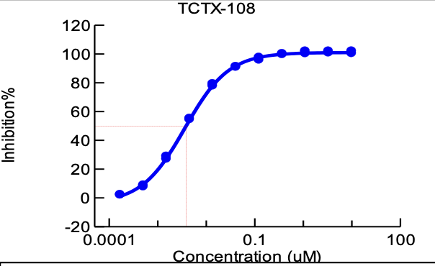
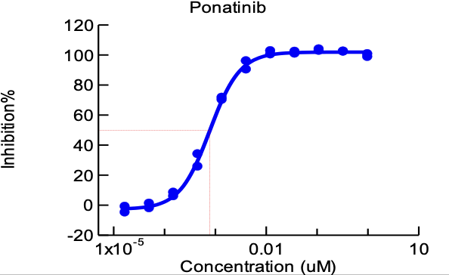
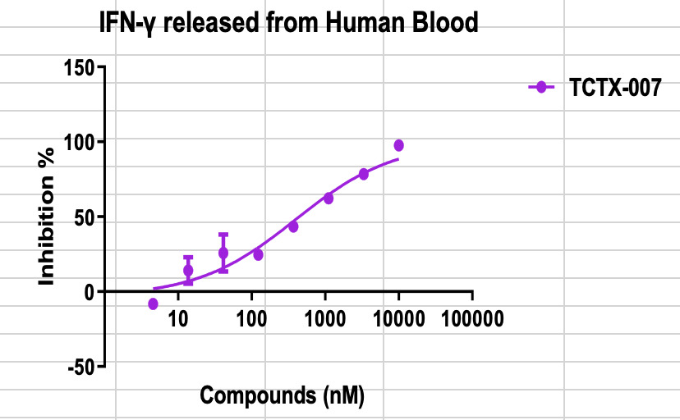
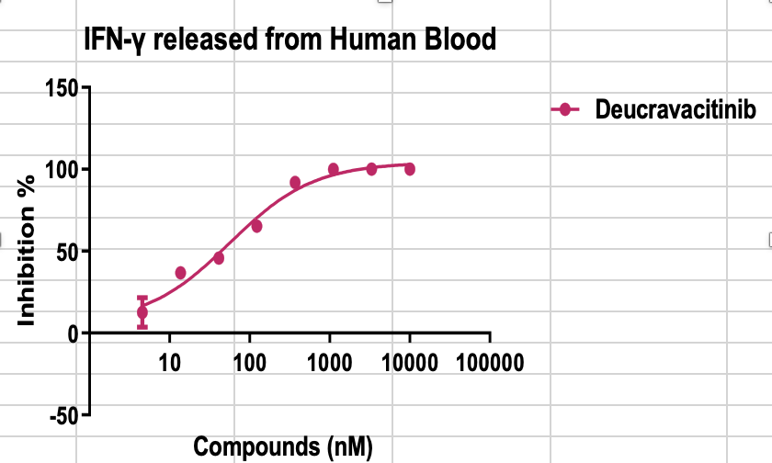
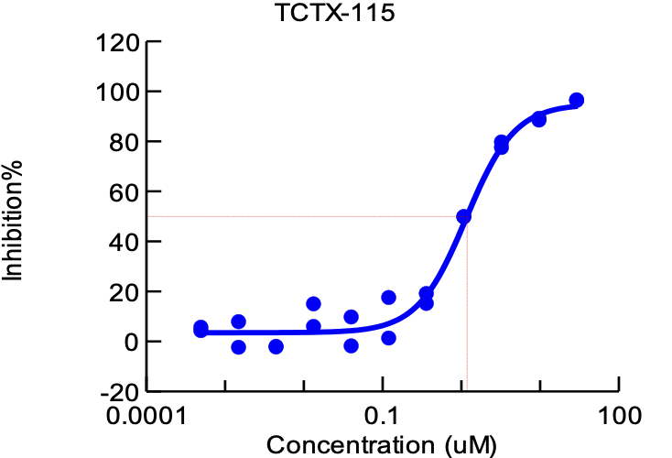
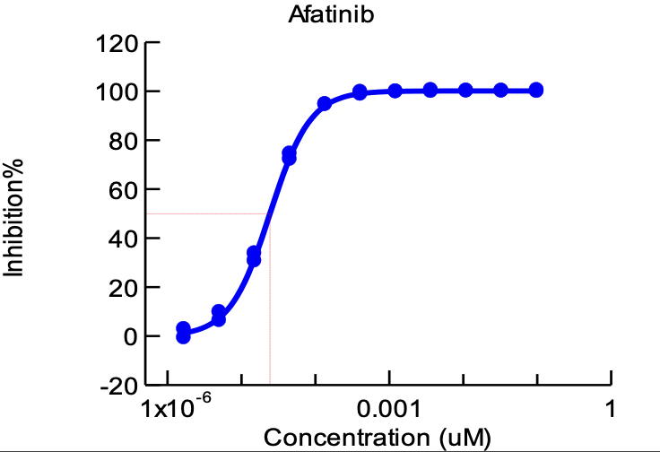
Validation of Our Design Platform
TCTX Lead
Approved Drug
CNS Penetrant CML Target Lead
(Patent pending)
Gut-restricted IBD Target Lead
(Patent pending)
CNS Penetrant NSCLC Target Lead
Our platform has demonstrated the capability to design novel, candidate-like lead compounds

Slide 10

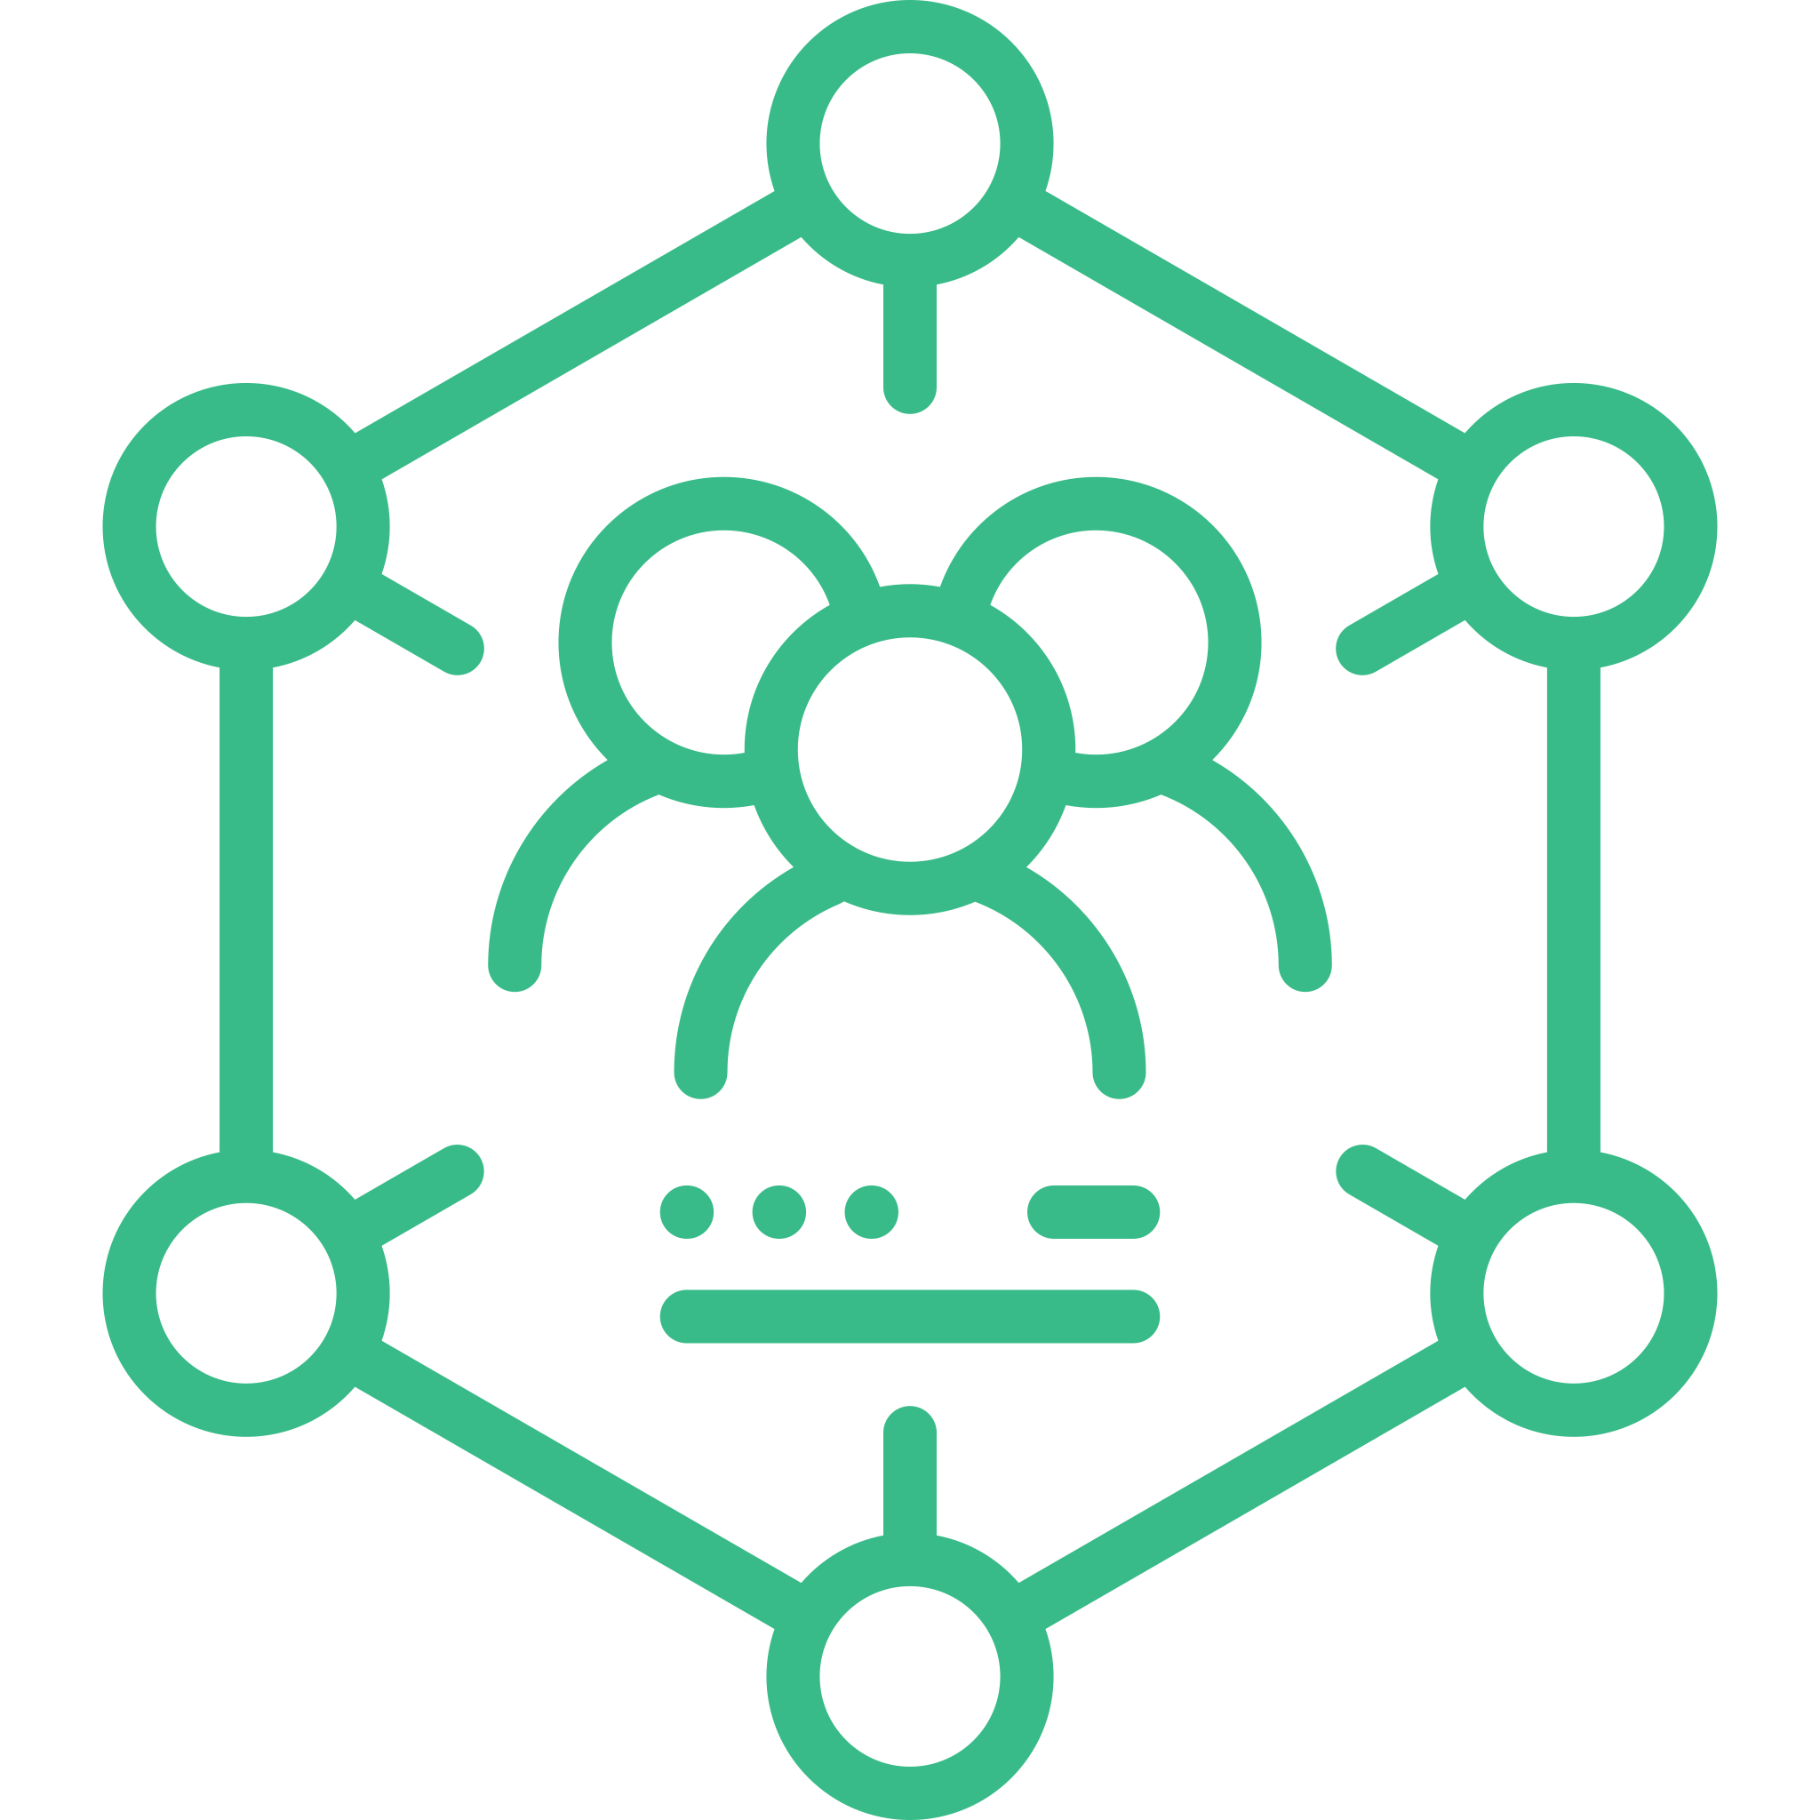

Drug Validation by DRUG-seq
DRUG-seq can directly compare the transcriptional profiles induced by the new drugs with those of competitor drugs.
NGS technologies, data analysis can provide critical insights into disease mechanisms, candidate drug validation, and patient responses.
This comparison can highlight differences in efficacy, resistance mechanisms, or cellular pathways, validating the new drug's clinical differentiation.
By integrating cutting-edge AI drug design with high-resolution genomic insights, we can accelerate the development of novel medicines.

Slide 11
Our AIDD Labs
The high throughput, high dimension and high-quality DRUG-seq data generated from our AIDD Labs will accelerate the development of novel medicines
Fast iteration leads to greater efficiency and superior models
Our AI labs automate synthesis and assays, slashing iteration time by over 70%
AI-Driven Iteration
New Data
AI Workflow
AIDD Labs
The combination of our AI Labs and AI Design capabilities can significantly improve lead optimization efficiency
New Designs

Slide 12
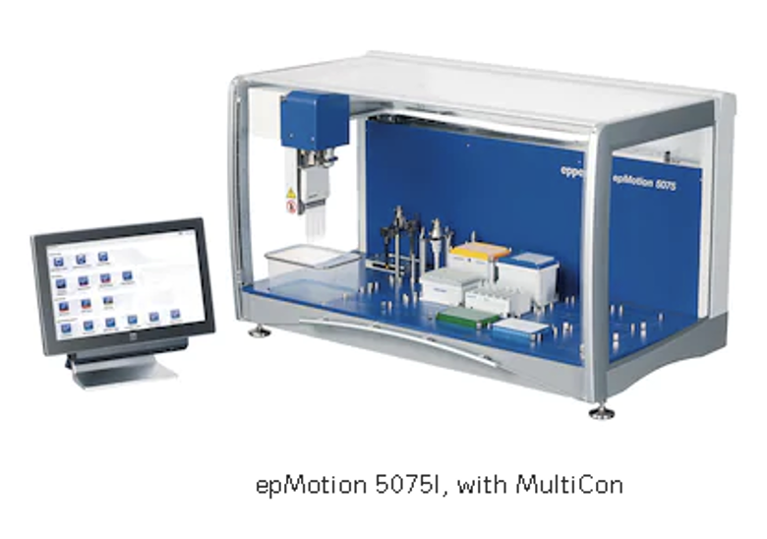
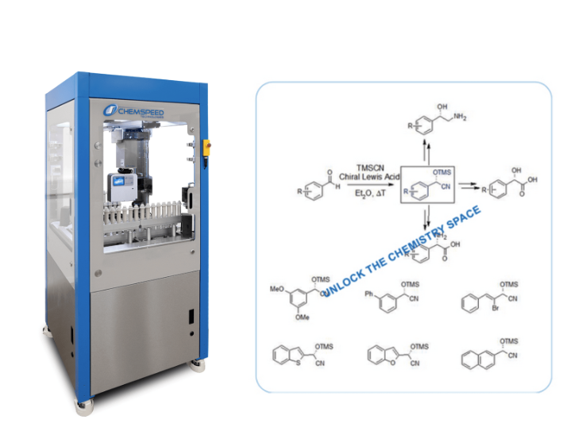
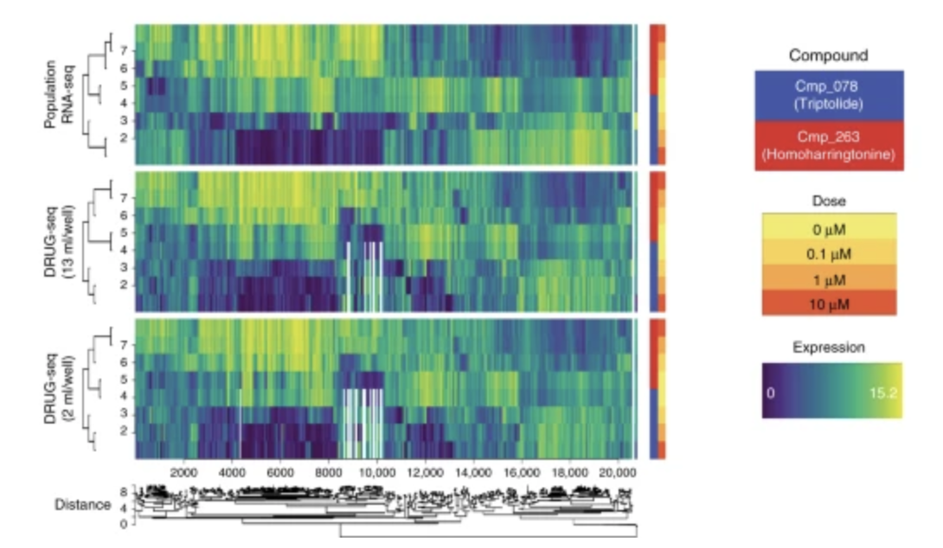
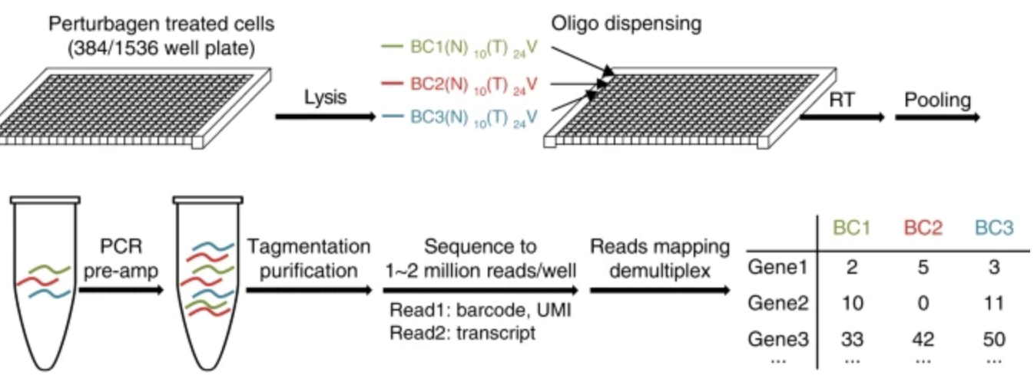
AI Labs - Building the Future
Our collaboration with BRAD (Hangzhou, China) focuses on developing AI Labs for AI-powered lead optimization

Slide 13
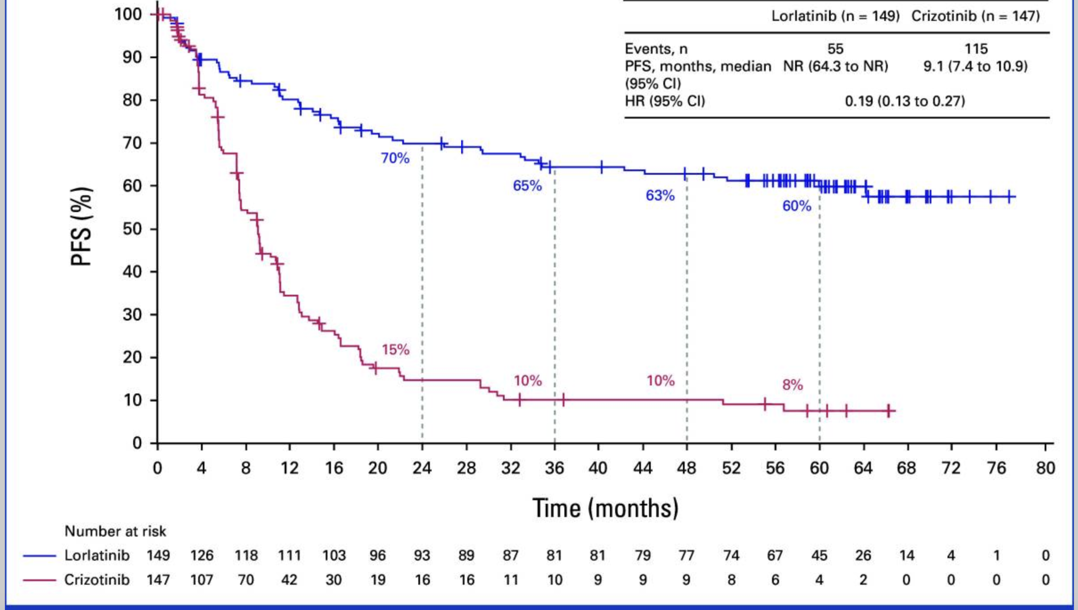
Our Project Portfolio: Best-in-Class
Many existing drugs provide limited clinical benefits despite their high costs
Me-too compounds show similar or inferior performance in clinical trials
Superior medicines create substantial real-world impact to the patients and society
Same target, different drugs
There is a high demand for novel and improved medicines to address unmet medical needs
PFS by investigator assessment in the intention-to-treat population
B.J. Solomon, G. Liu, E. Felip, et al.
J Clin Oncol, 42 (2024), pp. 3400-3409

Slide 14
Our Pipelines
Oncology
Our Lead Optimization Projects
Gut-restricted TYK2 inhibitors for IBD (in vivo validation)
CNS penetrant c-Abl inhibitors for neuron degenerative diseases (in vivo validation)
CNS penetrant BCR-Abl inhibitors for CNS relapse of AML
CNS penetrant EGFR mutants inhibitors (non-small cell lung cancer)
Our pipelines at Technetium Therapeutics center on key immunology and oncology diseases

Slide 15
Our Clinical Differentiation Strategy
Immunology
Majority of autoimmune diseases are organ specific
We set out to invent drugs with distributions limited to the specific organs (gut, lung, skins)
Organ-specific delivery drugs for organ-specific diseases maximizes drug effectiveness and minimizes systemic side effects
Only novel chemotypes can deliver meaningfully differentiated clinical profile

Slide 16
Our Clinical Differentiation Strategy
Oncology (Cancers)
Metastasis and drug resistance are two biggest challenges in cancer treatments
Our novel chemotypes are CNS penetrant, and potent to clinically relevant mutants
Our strategy of CNS penetrant, novel chemotypes can overcome both metastasis and drug resistance challenges
We set out to deliver truly novel cancer drugs to bring substantially better medicines

Slide 17



Our Business Model
Innovate, protect, and collaborate: file application of 10-20 PCT patents in the next two years
Maximize ROI by investing in preclinical drug development, where an initial $1 million–$5 million can yield returns ranging from $10 million to $1 billion
Achieve positive cashflow in 5 years: generate stream of revenues from patents out-license from 2026
Technetium Therapeutics strives to be the top hatchery for innovative medicines in 10 years

Slide 18



2025-2026 Finance and Business Plan
Non-dilutive funding - $700,000: build AI-Labs and high throughput genomic profiling labs
Team Building: Expanding our team to 8-10 employees to productionize AI agentic workflows and optimize lead operations
Equity investments - $10-15 million: Scaling to 10 LO projects, among them 2 clinical development candidate will be nominated
Efficient capital deployment is crucial for creating a productive hatchery of novel medicines

Slide 19
Techbio and Biotech Innovator
AI-driven Drug Design Platform
Company and pipeline update
https://www.tc43tx.com
Hosts Design Agent，Review Agent，Design-Review Iteration Workflow
https://www.technetiumtx.com
Our core business revolves around AI technology for drug design and novel drug development

Slide 20
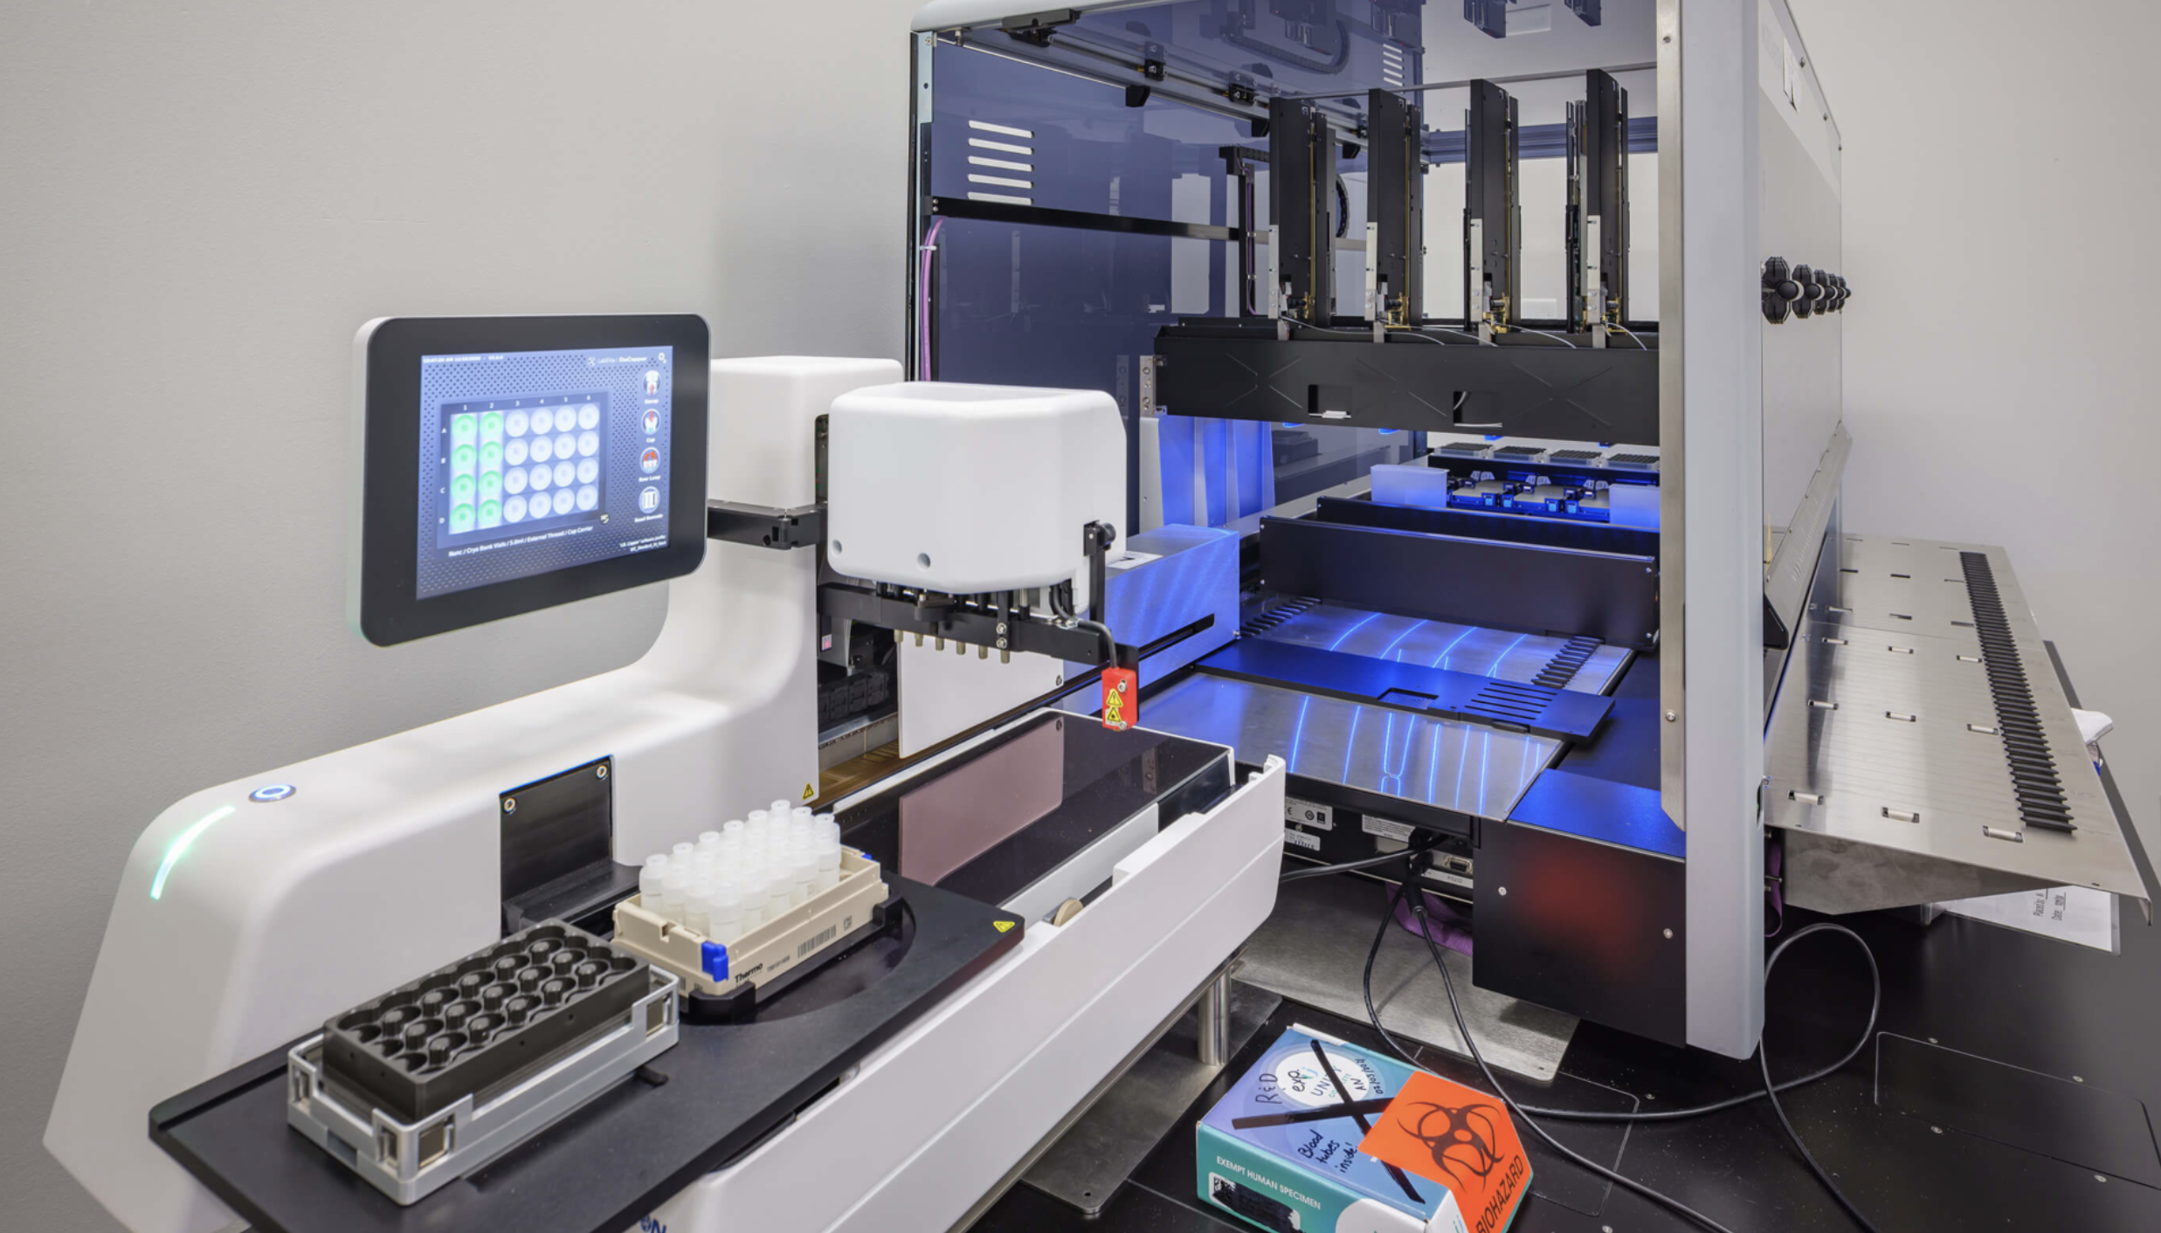
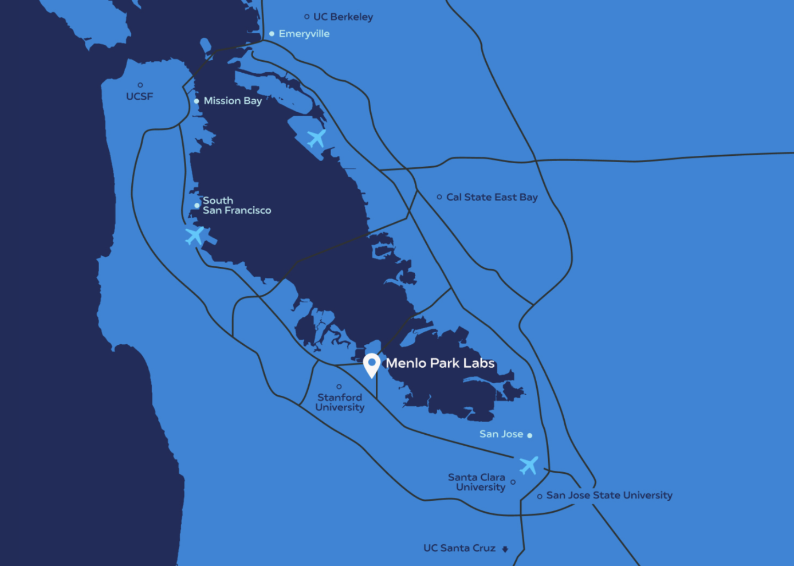
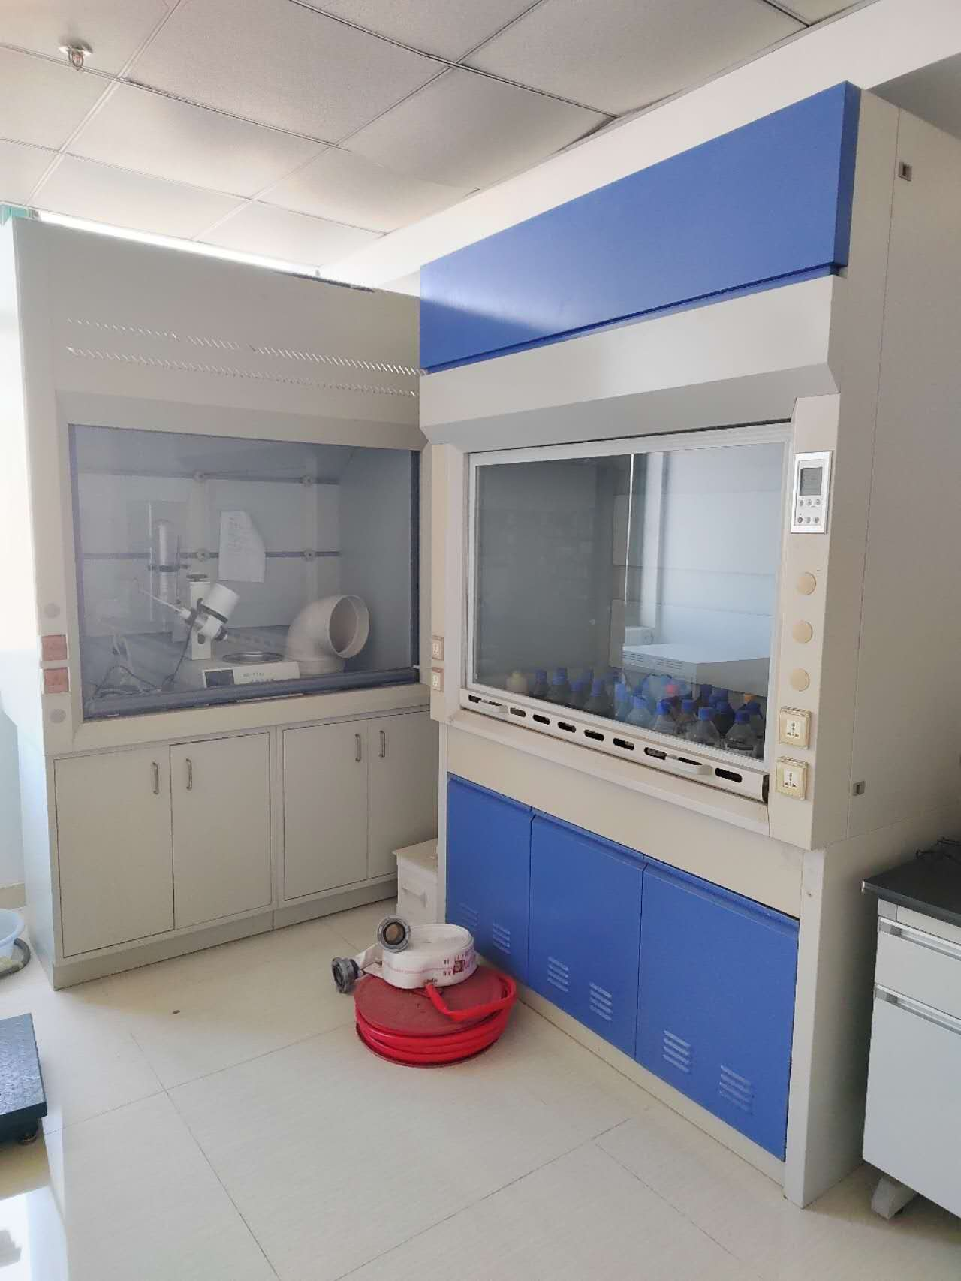
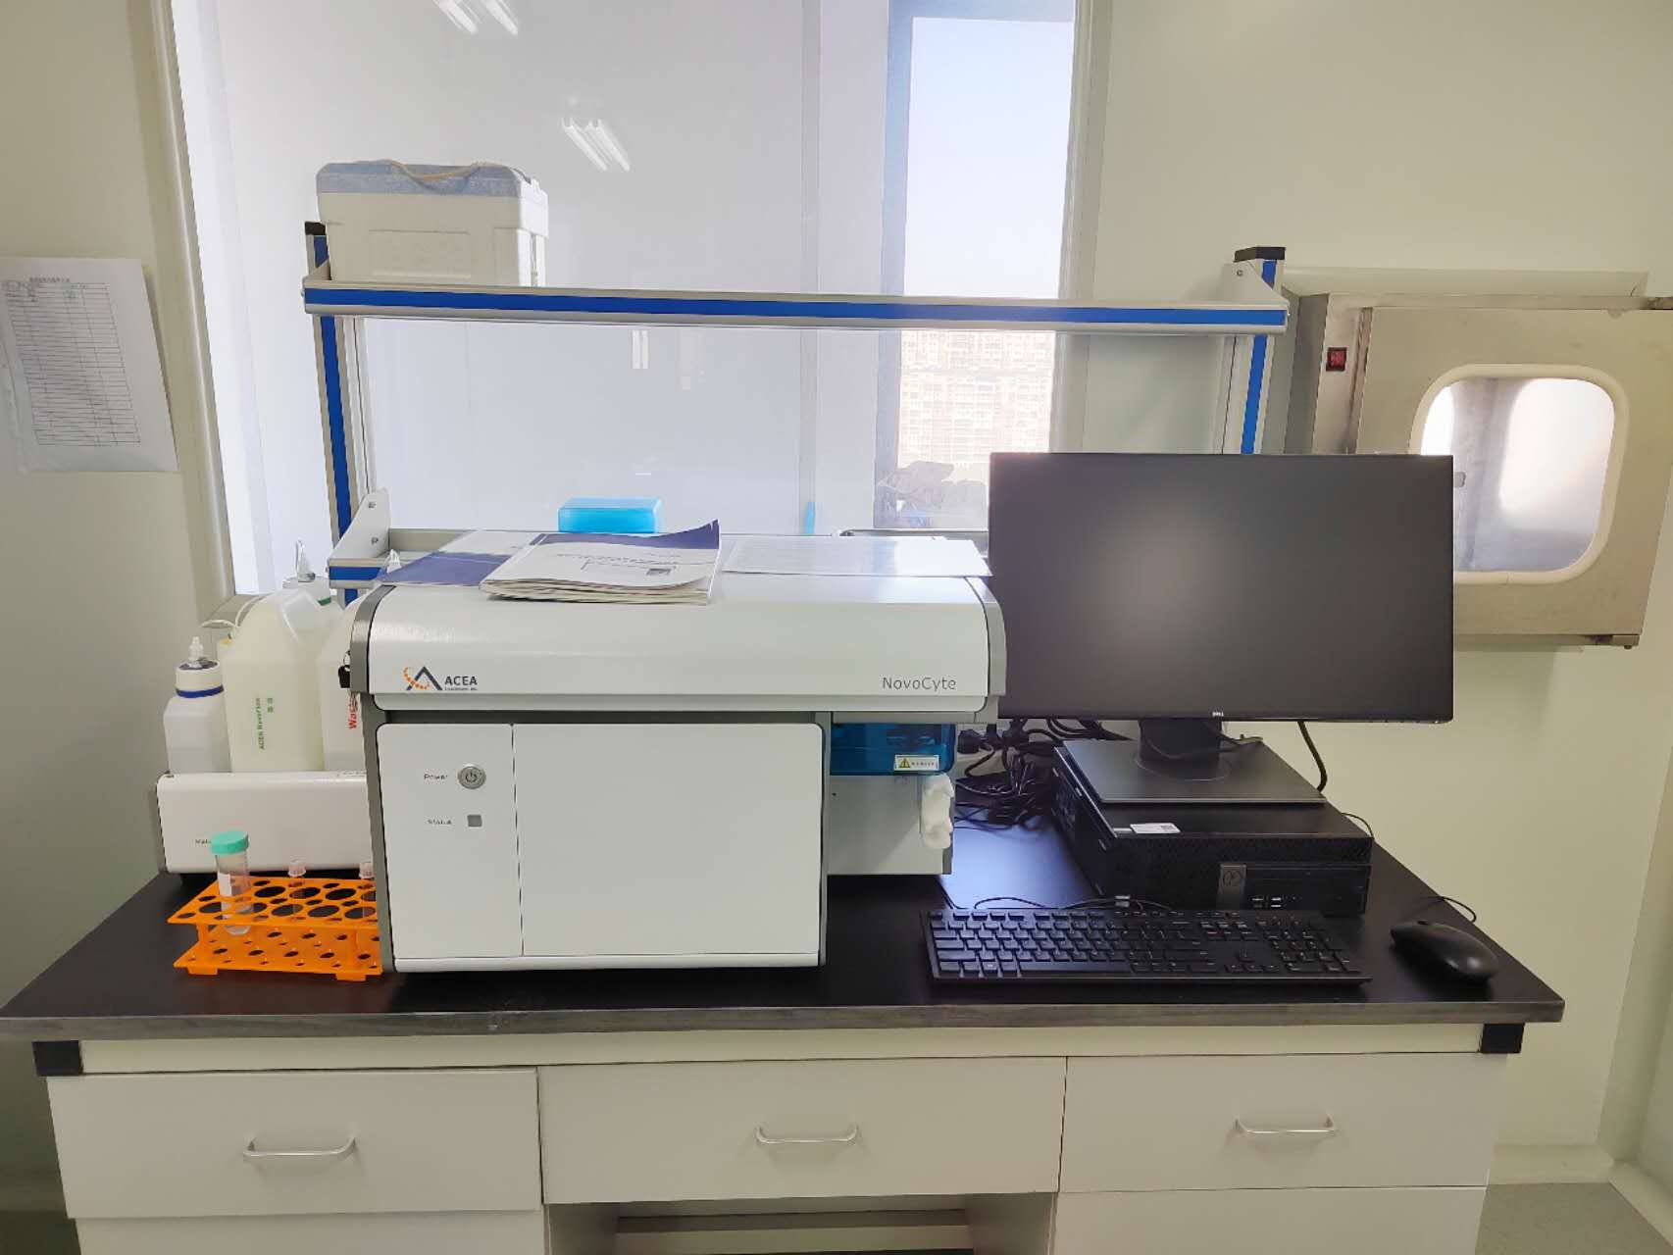
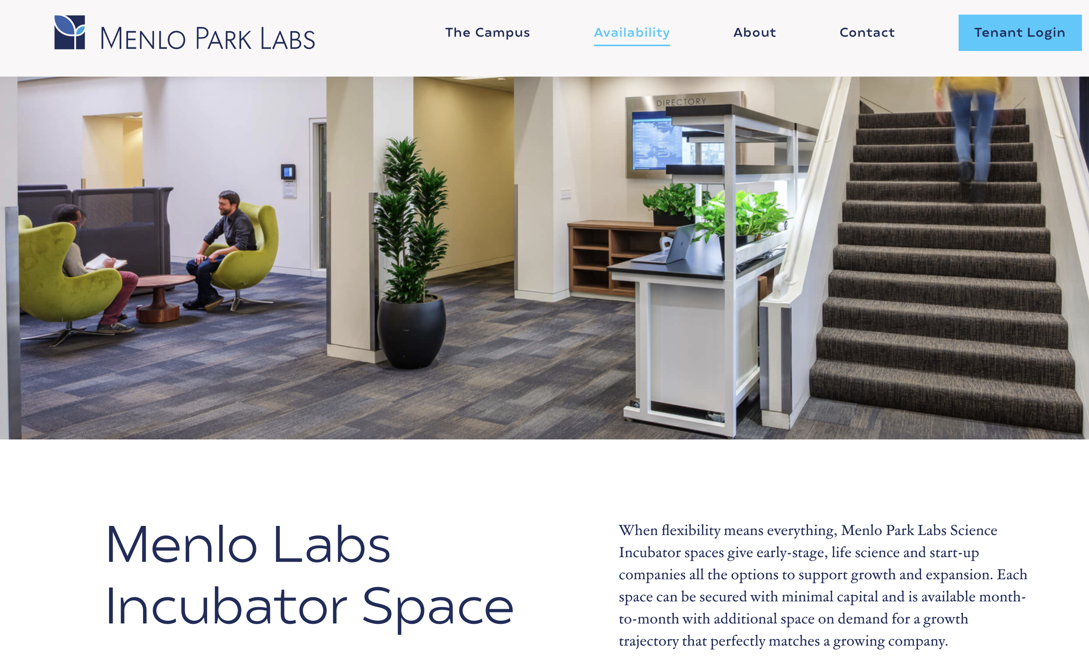
Our Current Facility
Menlo Park, our home, is the epicenter of the AI revolution and drug discovery breakthroughs

Slide 21




Contact Us
Join us in creating the AI-powered future of drug development
Cheng Hu
Address:
Technetium Therapeutics, Inc.
1455 Adams Drive, Suite 2160
Menlo Park, CA, 94025, USA
Visit our website:
https://www.technetiumtx.com
cheng@technetiumtx.com
1-650-455-9131

